Slide 1
Cyber Security and Ethical Hacking

Slide 2
Types of Blockchain Development
Core:
Core developer write the code for a blockchain client.
Low-level programming languages are used in writing blockchain clients.
Dapp:
Blockchain app developer is what most of blockchain developer do and it is what most people usually refer to when they mention blockchain development.
Here we build apps on top of a blockchain client instead of creating a whole blockchain from scratch.

Slide 3

Ethereum Blockchain
Ethereum blockchain is very popular.
Many promising blockchains such as Binance smart chain and the Tron blockchain are based on the Ethereum technology.

Slide 4
Ethereum Virtual Machine
The Ethereum Virtual Machine is the software platform that developers can use to create decentralized application (D. Apps) on Ethereum.
This virtual machine is where all Ethereum accounts and smart contracts live.

Slide 5
Smart Contracts
Smart contract is a program that lives on top of the blockchain and constitutes a set of rules agreed upon by the involved parties.
After the execution, if these set of rules are met, the smart contract executes itself to give an output.
The program enables decentralized automation by facilitating, verifying, and enforcing the conditions of an underlying agreement.
The self-executing feature of a smart contract is what makes it very important.
Smart contracts are stored on a blockchain that run when predetermined conditions are met.
They typically are used to automate the execution of an agreement so that all participants can be immediately certain of the outcome, without any intermediary's involvement or time loss.
Note: Solana blockchain uses rust for smart contract.

Slide 6
Ethereum Networks
1. MAIN NET: Actual bitcoin transfer, actually whatever application running on ethereum. whatever really accessing or having real values/expand some money.
real transaction broadcast.
Rest both (TestNet & Local Blockchain) for test purpose.
2. TEST NET: for testing purpose, before deploying blockchain into MAIN NET.
Test Net doesn't require real ether.
Test Net of Ethereum are Rinkeby, Ropsten, Goerli, Kovan.
Open online website, search>>foset for fake ether.

Slide 7
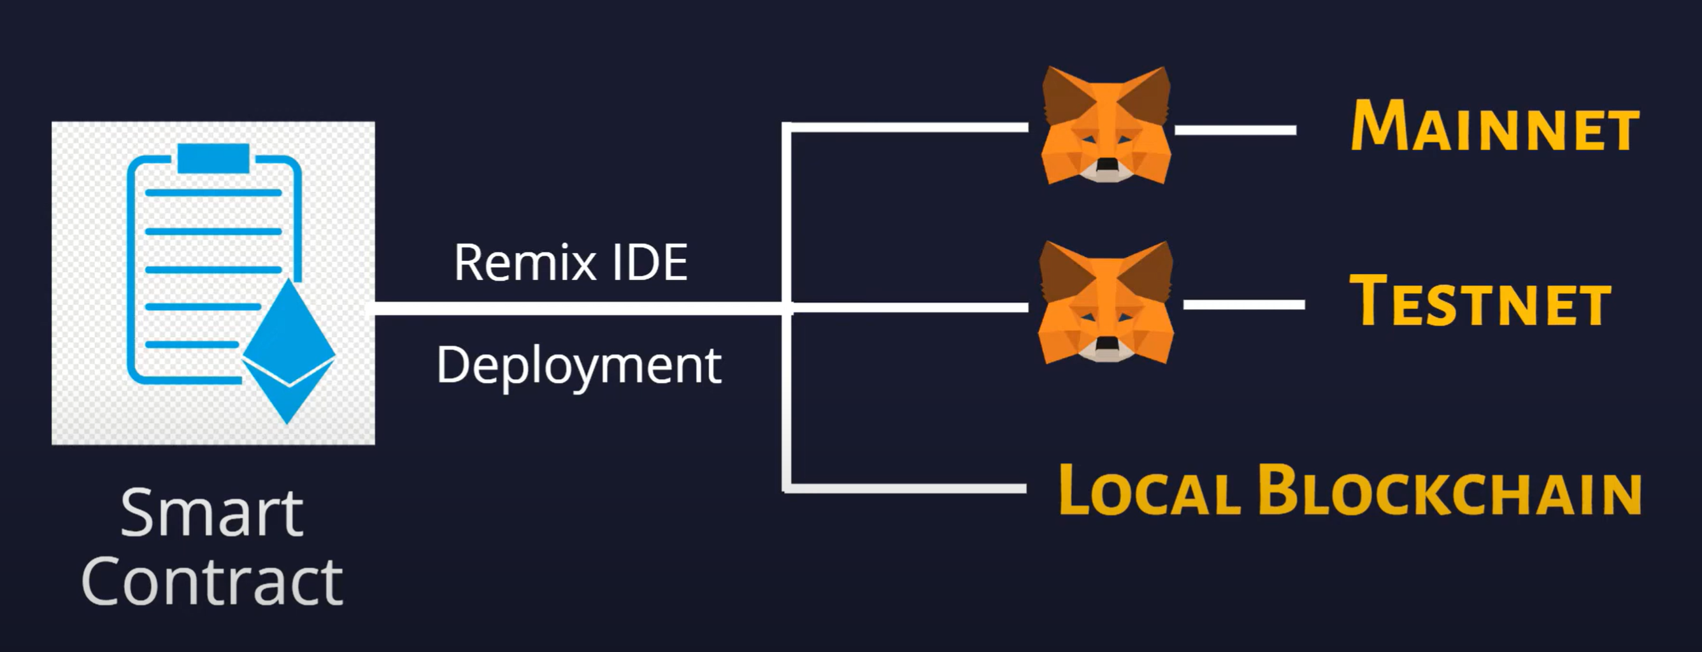
Ethereum Networks
3. LOCAL BLOCKCHAIN: Run locally. unlike MainNet and TestNet, local blockchain can not be accessible from anywhere.

Slide 8
Solidity Overview
Solidity is a contract-oriented, high-level programming language for implementing smart contracts.
There are a couple of programming languages used in writing smart contract, but solidity is one that very popular.
Solidity is highly influenced by C++, Python and JavaScript and has been designed to target the Ethereum Virtual Machine (EVM).
Solidity is statically typed programming language.

Slide 9
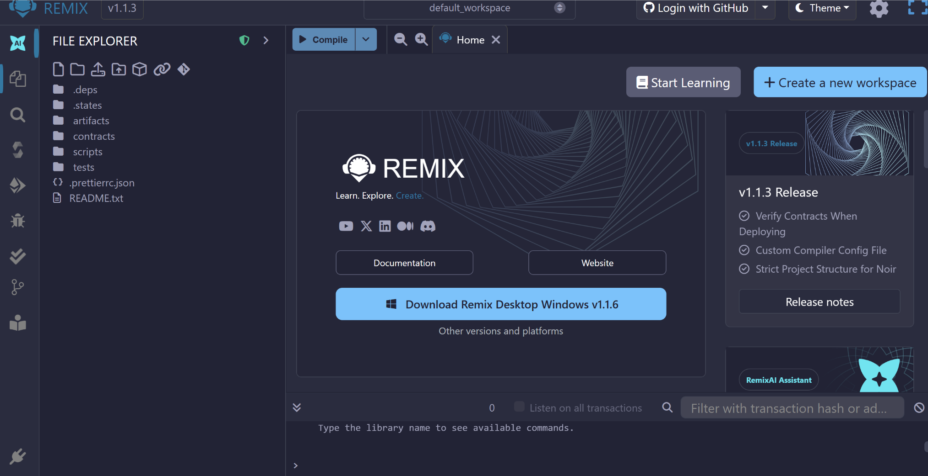
Solidity Overview
Smart contract using Solidity can write on web-based IDE that is Remix IDE.
remix.ethereum.org

Slide 10
Code Structure
// SPDX-License-Identifier: Unlicensed
pragma solidity >= 0.4.0;
contract Basic{
// Code write here...
}

Slide 11
Code Structure
Pragma
The first line is a pragma directive which tells that the source code is written for Solidity version 0.4.0 or anything newer that does not break functionality up to, but not including, version 0.6.0.
A pragma directive is always local to a source file and if you import another file, the pragma from that file will not automatically apply to the importing file.
So, a pragma for a file which will not compile earlier than version 0.4.0 and it will also not work on a compiler starting from version 0.5.0 will be written as follows −
pragma solidity ^0.4.0;
Here the second condition is added by using ^.

Slide 12
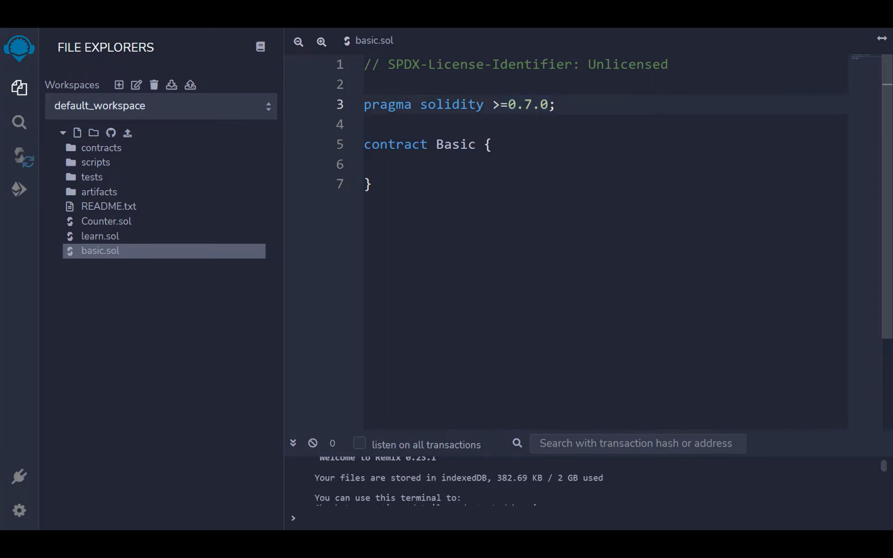
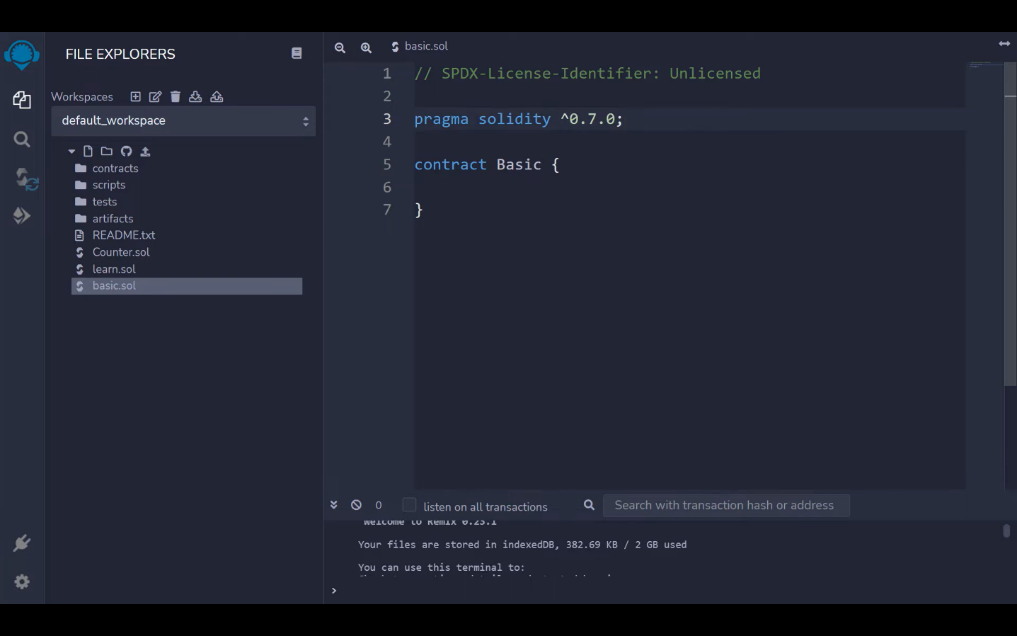
Version Discussion

Slide 13
Example of Smart Contract
// SPDX-License-Identifier: Unlicensed
pragma solidity >= 0.7.0;
contract Basic{
string public name="Indian Institute of Technology“;
}
Check ABI and bytecode under Compilation

Slide 14
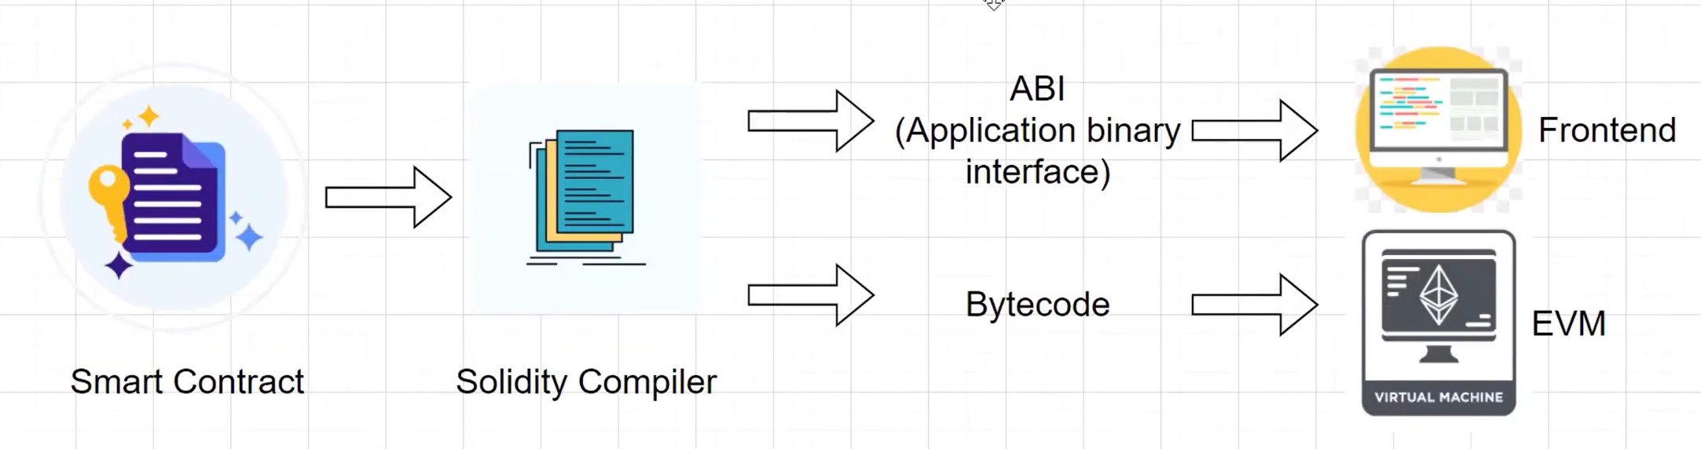
Compilation Process

Slide 15
Compilation Process
Before deploy smart contract, we need to compile solidity code to Bytecode for EVM.
We will get two things after compiling solidity code:
Bytecode/EVM code
ABI (Application Binary Interface)
Bytecode is code EVM execute in blockchain network.
ABI define the actions you interact with smart contract.
The actions in ABI mean the functions of smart contract.

Slide 16
Comments
Comments are not readable by solidity compiler or can say ignored by Solidity Compiler.
Solidity supports both C-style and C++-style comments, Thus −
In general:
Single line comment: started with //
Multi-line comment: This may span multiple lines.
/*
text to comment
*/

Slide 17
Keywords
Keywords are reserved word.
Reserved keywords in Solidity −
bool | address | bytes | enum | typedef | uint
auto | constant | switch | case | define | default
if | else | for | while | break | continue
pure | view | payable | override | in | let
function | return | inline | macro | require | match
mapping | modifier | static | struct | revert | null
this | reference | assembly | mutable | super | partial
event | new | fallback | relocatable | sealed | sizeof
private | public | internal | external | of | promise
abstract | after | alias | apply | immutable | supports
try | catch | final | unchecked | copyof | Typeof
pragma | contract | implements

Slide 18
Solidity Types
Solidity is a statically typed language, which implies that the type of each of the variables should be specified.
Data types allow the compiler to check the correct usage of the variables.
The declared types have some default values called Zero-State, for example for bool the default value is False.
Likewise other statically typed languages Solidity has following defined below:
  Value types
  Reference Types

Slide 19
Solidity Types
1. Value types:
Solidity offers the programmer a rich assortment of built-in as well as user defined data types.
Value type variables store their own data.
These are the basic data types provided by solidity.
These types of variables are always passed by value.
The variables are copied wherever they are used in function arguments or assignments.

Slide 20
Solidity Types
Value type data types in solidity are listed below:
Boolean: This data type accepts only two values True or False.
Integer: This data type is used to store integer values, int and uint are used to declare signed and unsigned integers respectively.
Fixed Point Numbers: These data types are not fully supported in solidity yet, as per the Solidity documentation. They can be declared as fixed and unfixed for signed and unsigned fixed-point numbers of varying sizes respectively.
Enums: It is used to create user-defined data types, used to assign a name to an integral constant which makes the contract more readable, maintainable, and less prone to errors. Options of enums can be represented by unsigned integer values starting from 0.

Slide 21
Solidity Types
Value type data types in solidity are listed below:
Address: Address hold a 20-byte value which represents the size of an Ethereum address.
An address can be used to get the balance using .balance method and can be used to transfer balance to another address using .transfer method.
address x = 0x212;
address myAddress = this;
if (x.balance < 10 && myAddress.balance >= 10) x.transfer(10);
Bytes: Although bytes are similar to strings, there are some differences between them. bytes used to store a fixed-sized character set while the string is used to store the character set equal to or more than a byte. The length of bytes is from 1 to 32, while the string has a dynamic length. Byte has the advantage that it uses less gas, so better to use when we know the length of data.

Slide 22
Solidity Types
Example: The contract Types initialize the values of different types of Values Types.
// SPDX-License-Identifier: GPL-3.0
pragma solidity >=0.4.22 <0.9.0;
//A contract for demonstrate Value types
contract Types {
bool public boolean = false; // Initializing Bool variable
int32 public int_var = -60313; // Initializing Integer variable
string public str = “IIT"; // Initializing String variable
bytes1 public b = "a"; // Initializing Byte variable
enum my_enum { Raman_, _for, _Raman } // Defining an enumerator
// Defining a function to return values stored in an enumerator
function Enum() public pure returns(my_enum) {
return my_enum._geeks;
}
}

Slide 23
Solidity Types
Following table lists down seven basic C++ data types −
Type | Keyword | Values
Boolean | bool | true/false
Integer | int/uint | Signed and unsigned integers of varying sizes.
Integer | int8 to int256 | Signed int from 8 bits to 256 bits. int256 is the same as int.
Integer | uint8 to uint256 | Unsigned int from 8 bits to 256 bits. uint256 is the same as uint.
Fixed Point Numbers | fixed/unfixed | Signed and unsigned fixed-point numbers of varying sizes.

Slide 24
Solidity Types
2. Reference Types
Reference type variables store the location of the data.
They don't share the data directly.
With the help of reference type, two different variables can refer to the same location where any change in one variable can affect the other one.

Slide 25
Solidity Types
Reference types in solidity are listed below:
Arrays: An array is a group of variables of the same data type in which the variable has a particular location known as an index. By using the index location, the desired variable can be accessed. The array size can be fixed or dynamic.
Strings: Strings are like arrays of characters. When we use them, we might occupy bigger or shorter storage space.
Struct: Solidity allows users to create and define their own type in the form of structures. The structure is a group of different types even though it's not possible to contain a member of its own type. The structure is a reference type variable that can contain both value type and reference type
Mapping: Mapping is the most used reference type, that stores the data in a key-value pair where a key can be any value type. It is like a hash table or dictionary as in any other programming language, where data can be retrieved by key.

Slide 26
Solidity Types
Example: The contract Types initialize the values of various Reference Types.
// SPDX-License-Identifier: GPL-3.0
pragma solidity >=0.4.22 <0.9.0;
//A contract for demonstrate Reference types
contract mapping_example {
uint[5] public array= [uint(1), 2, 3, 4, 5]; // Defining an array
// Defining a Structure
struct student {
string name;
string subject;
uint8 marks;
}
// Creating a structure object
student public std1;
// Defining a function to return values of the elements of the structure
function structure() public returns(string memory, string memory, uint){
std1.name = "John";
std1.subject = "Chemistry";
std1.marks = 88;
return (
std1.name, std1.subject, std1.marks);
}
// Creating a mapping
mapping (address => student) result;
address[] student_result;
}

Slide 27
Naming Convention of Variable
While naming your variables in Solidity, keep the following rules in mind.
A variable name should start with an alphabet. It can be alpha-numeric.
Variable names should not start with a numeral (0-9).
A variable name can not have any special symbol only underscore are allowed.
They must begin with a letter or an underscore character.
A variable name should not have any blank space.
Variable name can not take as reserved words (keywords).
Solidity variable names are case-sensitive.

Slide 28
Types of Variable
Solidity supports three types of variables.
1. State variables: Variable whose values are permanently stored in a contract storage.
2. Local Variables: Variables whose values are present till function is executing.
3. Global Variables: Special variables exists in the global namespace used to get information about the blockchain.
Solidity is a statically typed language, which means that the state or local variable type needs to be specified during declaration.
Each declared variable always have a default value based on its type.
There is no concept of "undefined" or "null".

Slide 29
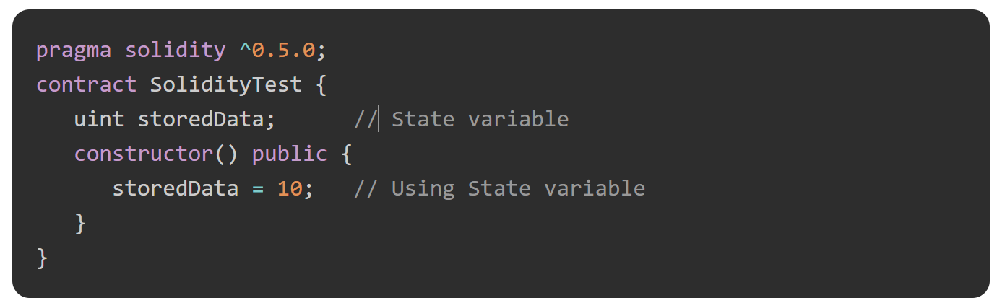
1. State Variable
Variables whose values are permanently stored in a contract storage.

Slide 30
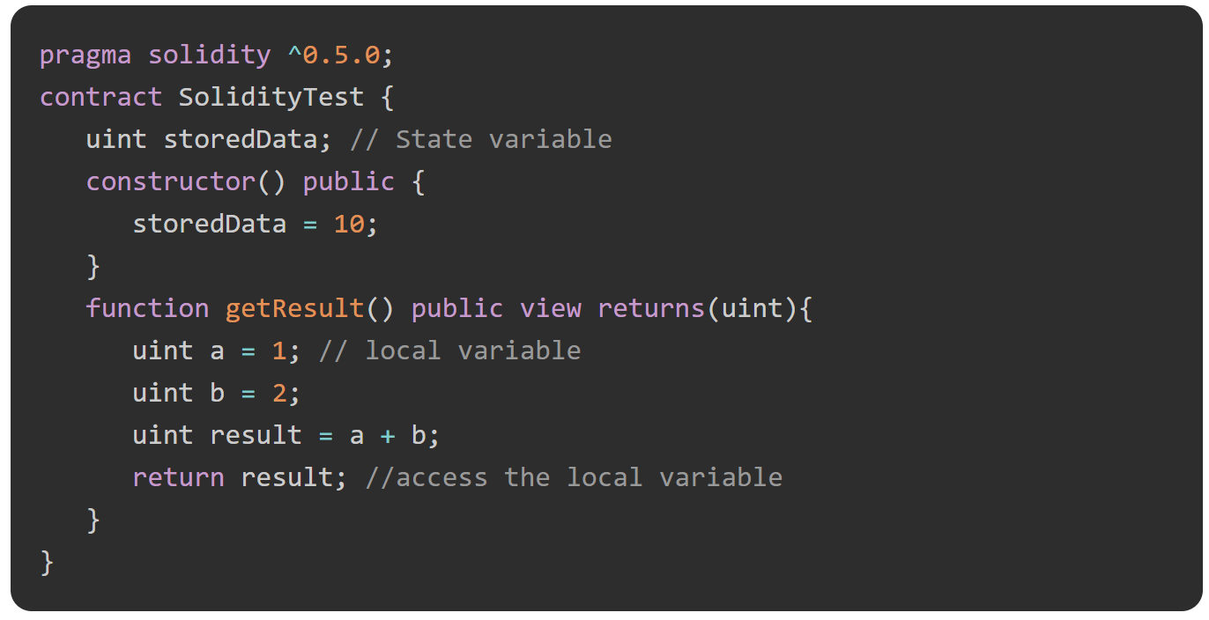
2. Local Variable
Variables whose values are available only within a function where it is defined.
Function parameters are always local to that function.

Slide 31
3. Global Variable
These are special variables which exist in global workspace.
Provide information about the blockchain and transaction properties.
Name | Returns
blockhash(uint blockNumber) returns (bytes32) | Hash of the given block - only works for 256 most recent, excluding current, blocks
block.coinbase (address payable) | block miner's address
block.difficulty (uint) | Current block difficulty
block.gaslimit (uint) | Current block gaslimit
block.number (uint) | Current block number
block.timestamp (uint) | Current block timestamp as seconds since unix epoch
gasleft() returns (uint256) | Remaining gas

Slide 32
3. Global Variable
These are special variables which exist in global workspace.
Provide information about the blockchain and transaction properties.
Name | Returns
msg.data (bytes calldata) | Complete calldata
msg.sender (address payable) | Sender of the message (current caller)
msg.sig (bytes4) | First four bytes of the calldata (function identifier)
msg.value (uint) | Number of wei sent with the message
now (uint) | Current block timestamp
tx.gasprice (uint) | Gas price of the transaction
tx.origin (address payable) | Sender of the transaction

Slide 33
Visibility Specifiers or Variable Scopes
Solidity function visibility specifiers:
public (default for functions) : public state variables can be accessed internally as well as via message. For a public state variable, an automatic getter function is generated.
visible externally and internally (including getter functions for storage/state variables)
private: Private state variables can be accessed only internally from the current contract they are defined not in the derived contract from it. only visible in the current contract.
internal: Internal state variables can be accessed only internally from the current contract or contract deriving from it without using this. Can be called by the current contract or any derived contracts.
external: only visible externally, however can be accessed within the current contract via 'this.func'

Slide 34
Thankyou

